Slide 1
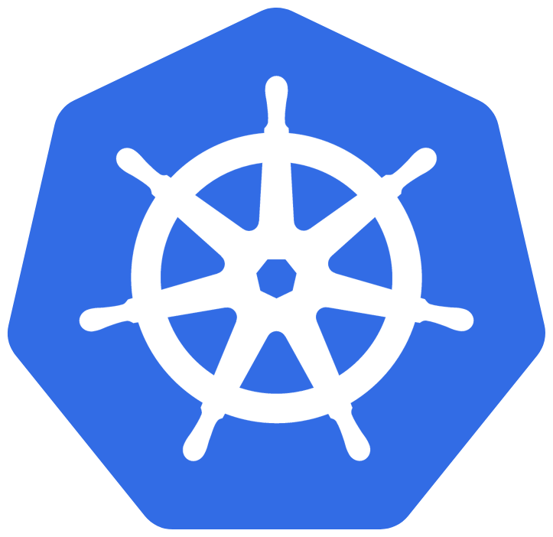
Kubernetes
Bite Size Session
Sabarish Gurajada – Service Engineer
Consumer Servicing Value Stream
Customer contacts lab

Slide 2
Agenda
Day1 : Kata cloud
Docker basics
K8’s architecture
K8’s components
Quiz – 1
Cloud components
Cloud hierarchy
Basic requirements
Namespace
Pod,
Quiz – 2
Replica set, deployment
Quiz -3
Services
Day2: GCP
Kubectl commands
Create
Edit
Describe
Logs
Delete
Get
Auto scaling
Quiz - 4
2. Helm, Tiller
3. Helm Structure
4. Helm Demo
Quiz - 5
5. Jenkins &Helm deployments

Slide 3
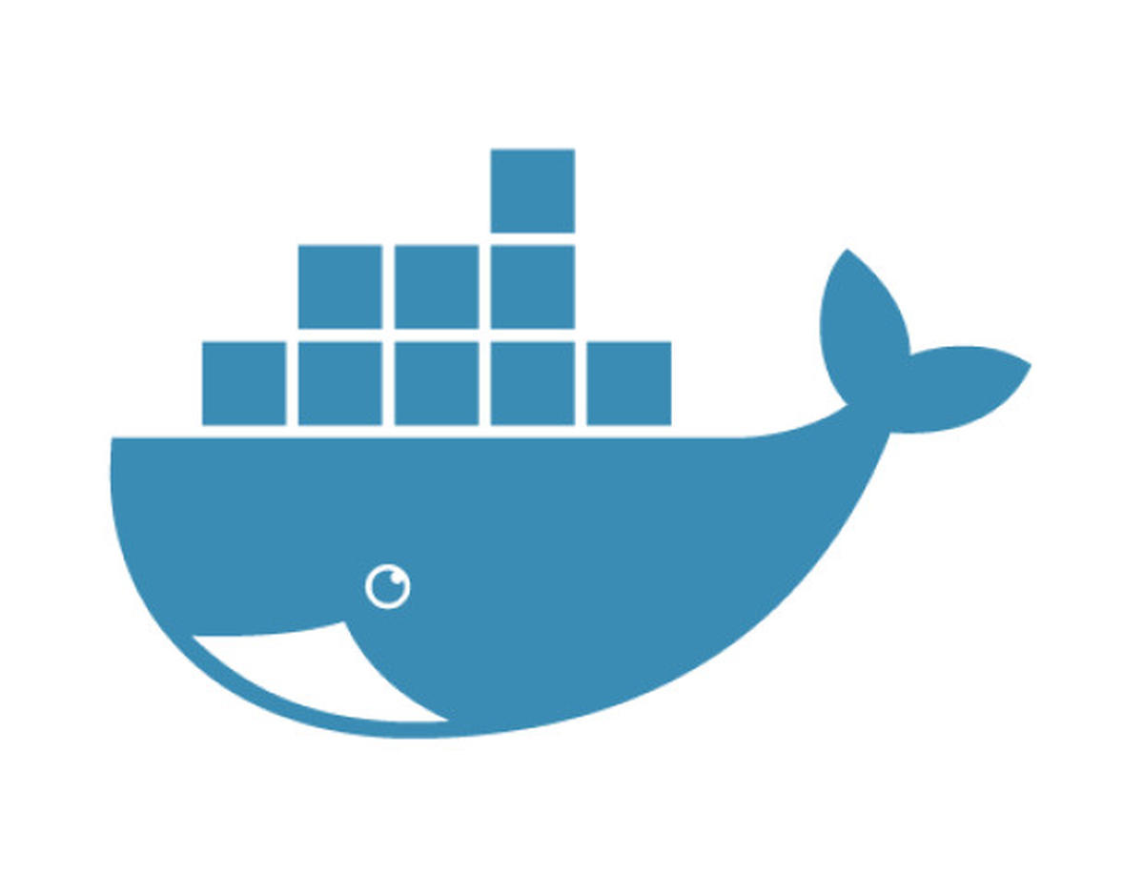
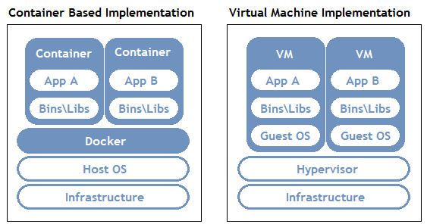
What is it?
An open source software used to manage your docker containers effectively.
It aims to provide a platform for automating deployment, scaling and operation
of application containers across clusters of hosts
Glimpse about docker

Slide 4
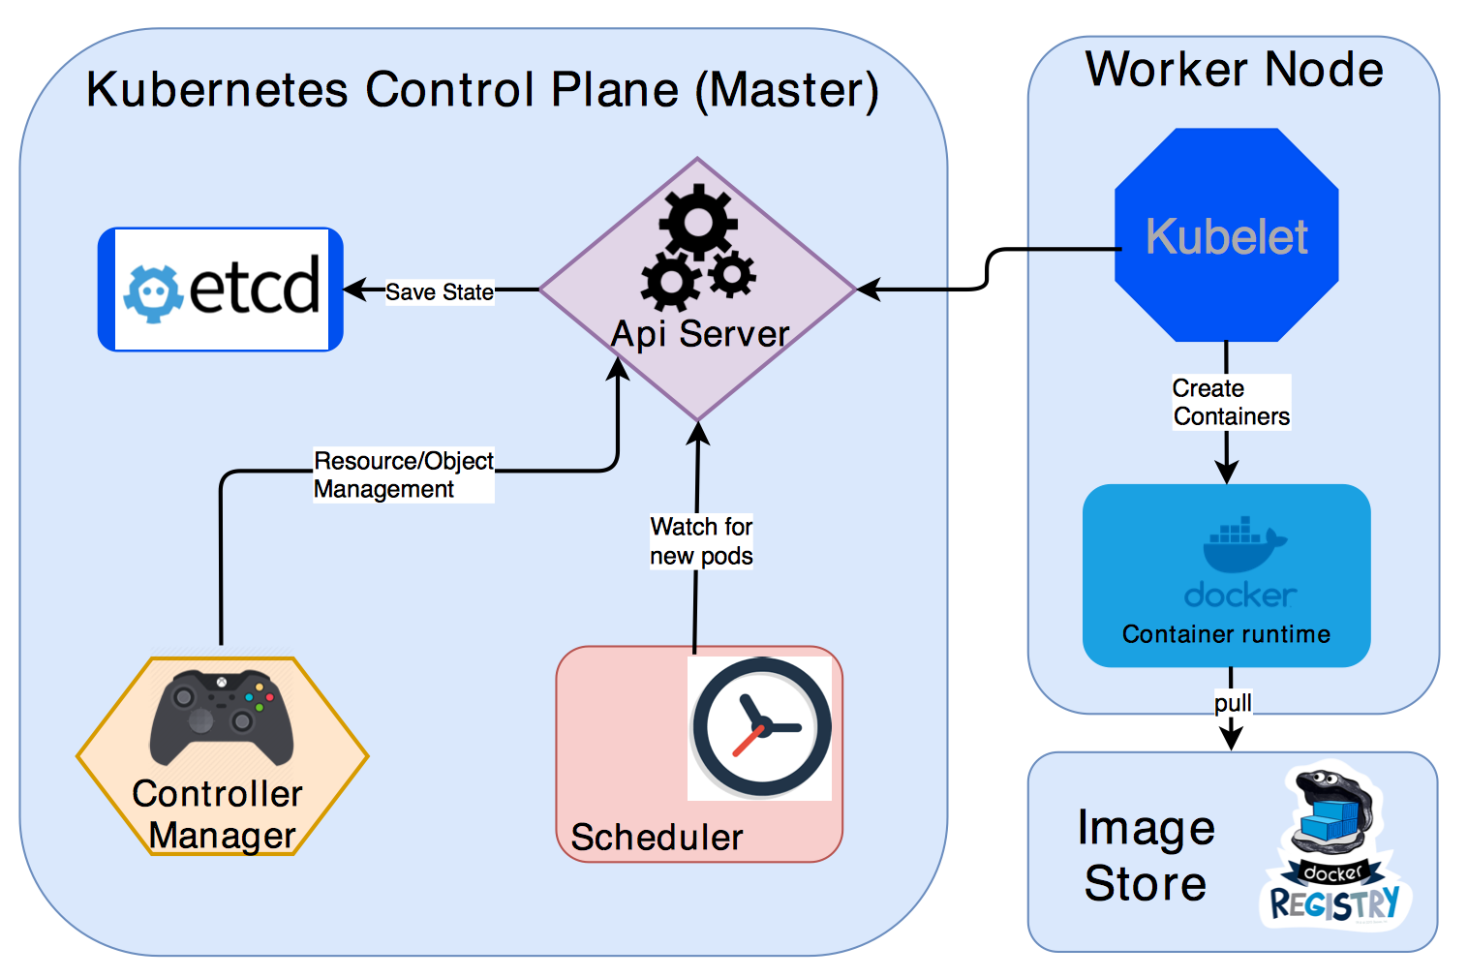
Architecture

Slide 5
K8s components
kube-apiserver
The API server is a component of the Kubernetes control plane that exposes the Kubernetes API. The API server is the front end for the Kubernetes control plane.
kube-proxy
kube-proxy is a network proxy that runs on each node in your cluster, implementing part of the Kubernetes Service concept.
etcd
Consistent and highly-available key value store used as Kubernetes' backing store for all cluster data.
kubelet
An agent that runs on each node in the cluster. It makes sure that containers are running in a Pod.
kube-scheduler
Control plane component that watches for newly created Pods with no assigned node, and selects a node for them to run on.
Container runtime
The container runtime is the software that is responsible for running containers.
kube-controller-manager
Control Plane component that runs controller processes.

Slide 6
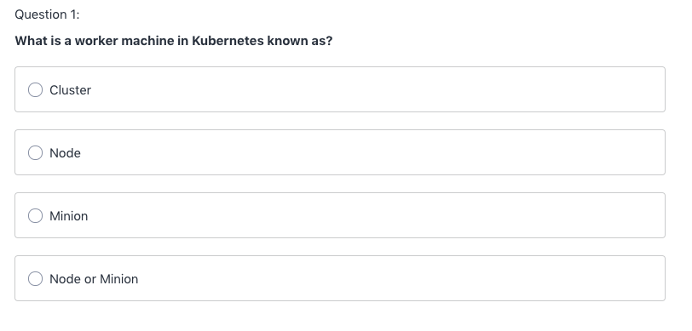
Quiz

Slide 7
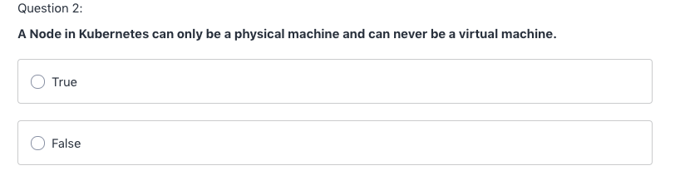
Quiz

Slide 8
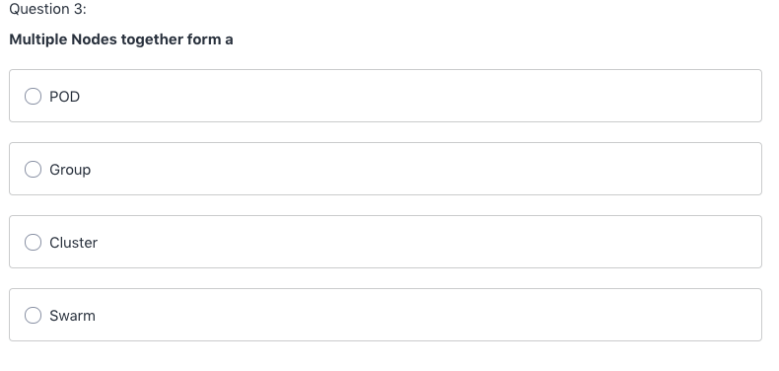
Quiz

Slide 9
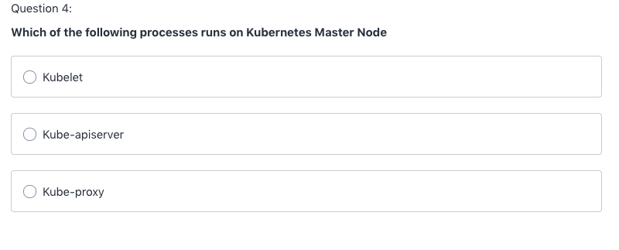
Quiz

Slide 10
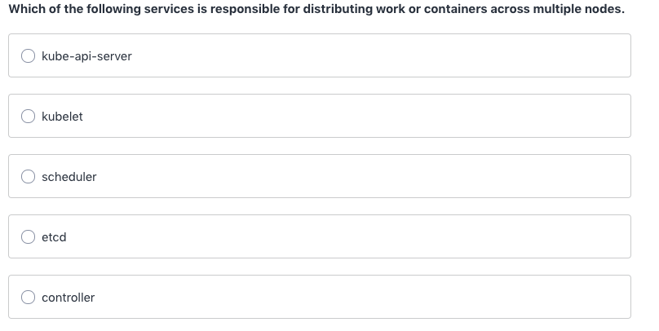
Quiz

Slide 11
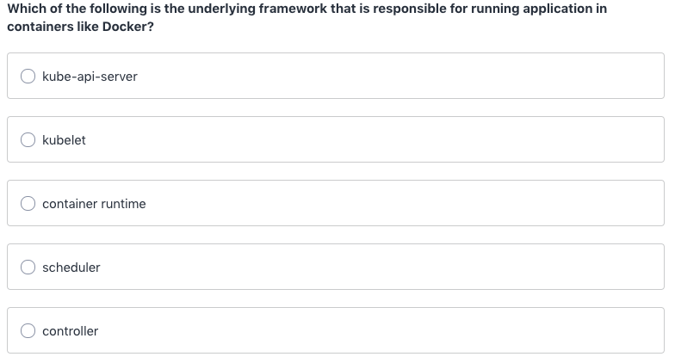
Quiz

Slide 12
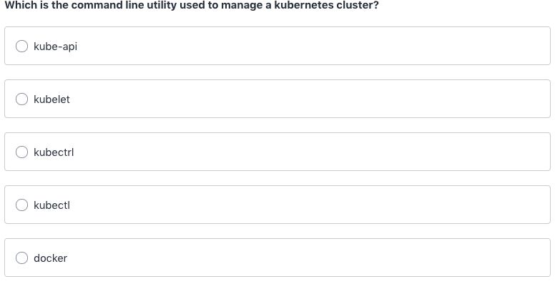
Quiz

Slide 13
Cloud components
Node: A physical machine in term of cloud it is virtual machine(minion)
POD: a smallest unit in kubernetes orchestration
Replica set: Controls no of replicas of pod
Deployment: Manages replica set with set of instructions
Cluster: Collection of nodes
Container: An image in execution
Namespace: Environments inside nodes

Slide 14
Cloud Architecture
Cluster
Cluster
Node
Namespace
Deployment
Replica set
Pod
Container

Slide 15
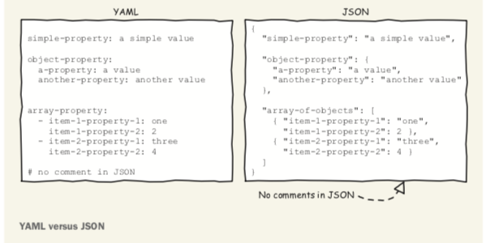
Basic requirements
Docker images
Yaml
Kubectl commands
Important tags of kubernetes yaml
apiVersion
kind
metadata
spec

Slide 16
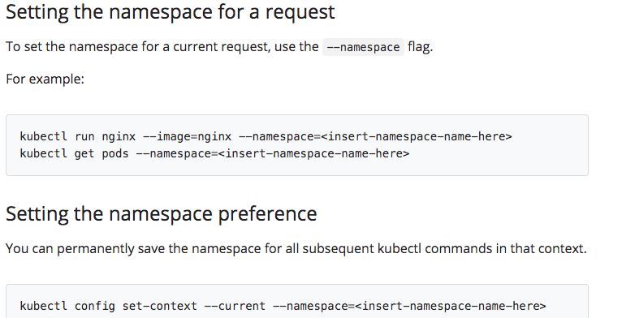
Namespace
Virtual partition inside your cluster

Slide 17
POD
Imperative:
Kubectl run <podname> --image=<image name>
Declarative:
apiVersion: v1
kind: Pod
metadata:
name: mynewpod
labels:
app: mypod
spec:
containers:
- name: nginx
image: nginx
apiVersion: v1
kind: Pod
metadata:
name: mynewpod
labels:
app: mypod
spec:
containers:
- name: nginx
image: nginx
- name: redis
image: redis

Slide 18
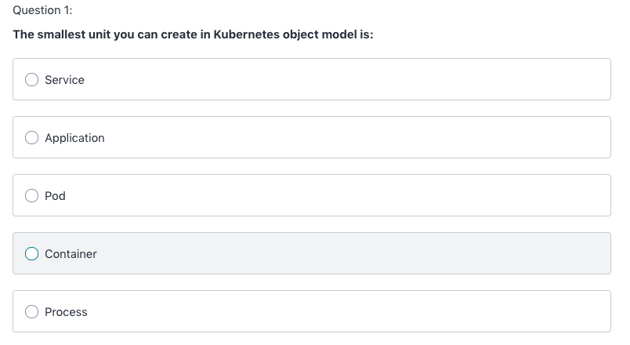
Quiz

Slide 19
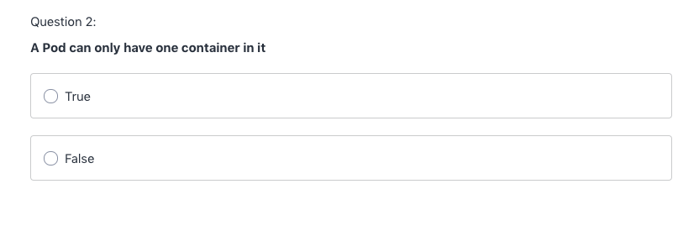
Quiz

Slide 20
Replica set
apiVersion: apps/v1
kind: ReplicaSet
metadata:
name: frontend
labels:
app: mywebsite
tier: frontend
spec:
replicas: 4
template:
metadata:
name: myapp-pod
labels:
app: myapp
spec:
containers:
- name: nginx
image: nginx
selector:
matchLabels:
app: myapp

Slide 21
Deployment
kubectl create deployment <deploym name> --image=<image name>
kubectl scale replicas=<NO> deployment/<name of deployment>

Slide 22
Quiz
I created a pod “my pod” and pod stopped working, kubernetes will
ensure always one pod is running, even if this pod is deleted.
True B. False
Once I have declare a replica set with replicas as 6 I cannot amend it any
further?
True B. False
3. I created a pod “my pod” with rs (5) “replica pod” and one of the pod
stopped working, kubernetes will ensure always one pod is running, even if
this pod is deleted.
True B. False
4. I can use below command which will increase my pod count
kubectl scale –replicas=6 pod/<name of pod>
A. True B. False

Slide 23
Service
Node Port
Cluster IP
Load Balancer
kubectl get service my-cip-service --output yaml → gives details in yaml format
kubectl get svc –o wide → give details including which node the service is running
kubectl exec –it <pod name> -- sh → go in to pod and check details
curl <cluster ip>:80 → to get details at cluster level
gcloud compute firewall-rules create <nameof firewall> --allow tcp:<node-port>

Slide 24
Kubectl Commands
Create – to create pod, deployment, namespace
Apply – if you have amended and need to update
EDIT – if you have to update any yaml file
Delete – to delete
Logs – to check logs of any objects
Scale – to scale replica set, deployments
Auto scaling – to set min, max of your resources
kubectl autoscale deployment my-deployment --cpu-percent=50 --min=1 --max=10
Describe – to know in details about your objects
Get – to get details about your objects running in cluster

Slide 25
Quiz
To make use of your service outside any cloud environment you have to use type as
LoadBalancer
NodePort
ClusterIP
2. Which command is used to list all the objects running inside your namespace?
3. Which command is used to know what image is running inside a container?
4. If I wanted to know on which node my service is running which command I can use?
-o wide
-o node
5. I can delete a container running inside a pod without disturbing a pod
True
False
6. Which among the following will collapse the objects completely
Deleting Pod
Deleting replica set
Deleting Deployment

Slide 26
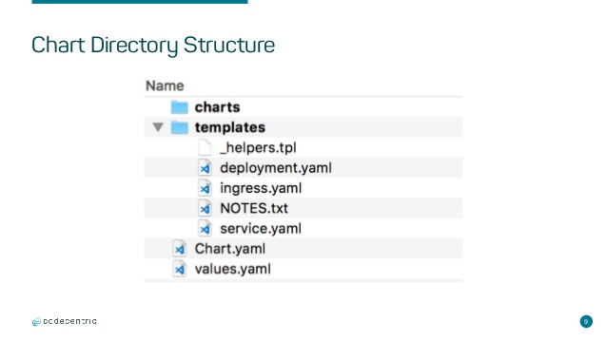
HELM & Tiller
Helm helps you manage Kubernetes applications — Helm Charts help you define, install, and upgrade even the most complex Kubernetes application.
Tiller is the service that actually communicates with the Kubernetes API to manage our
Helm packages

Slide 27
HELM DEMO
Easy yaml writing
Kubectl create deployment <name> --image=<imagename> --dry-run –o yaml > de.yaml
kubectl expose deployment <name> –port 80 –dry-run –o yaml > ser.yaml
Chart.yaml
apiVersion: v1
name: bitesize
version: 0.1.0
appVersion: 1.0
description: bitesize demo
List
Upgrade
Rollback
delete

Slide 28
QUIZ
Helm can communicate directly with kubernetes.
True B. False
2. Which Helm command will help us to get whole helm structure?
Upgrade B. List C. Create D. Install
3. What is the argument we need to pass in Helm rollback command?
4. If you delete helm release still pod will be running
A. True B. False

Slide 29
Thanks!!

